Slide 1

C1 discussion

Slide 2

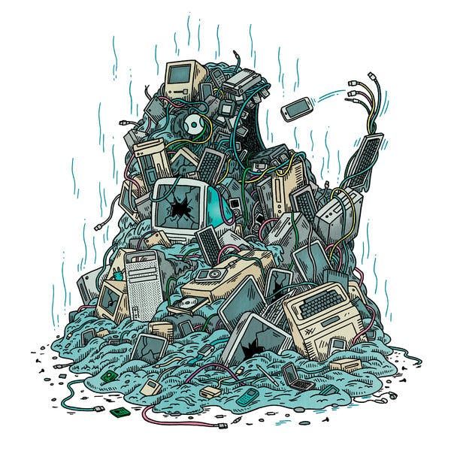

Slide 3
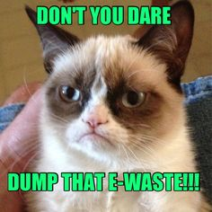

Slide 4
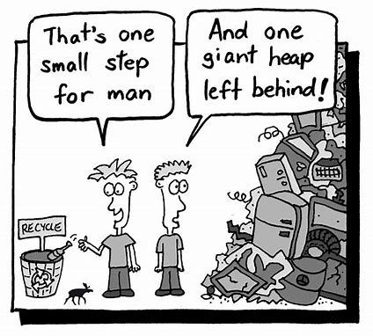

Slide 5
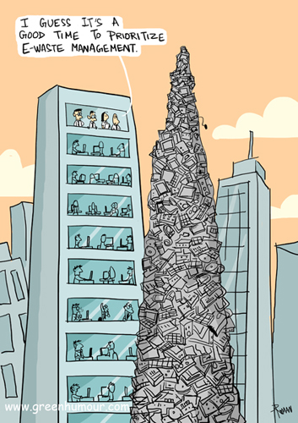

Slide 6

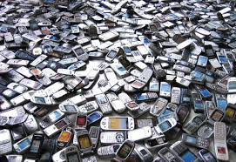
E-waste Journal Response
Artist: Von Wong
Year: 2018
Type of art: Photograph
https://www.youtube.com/watch?v=R3fjsi_-ypo

Slide 7
Title of first Artwork:
The spiral

Slide 8
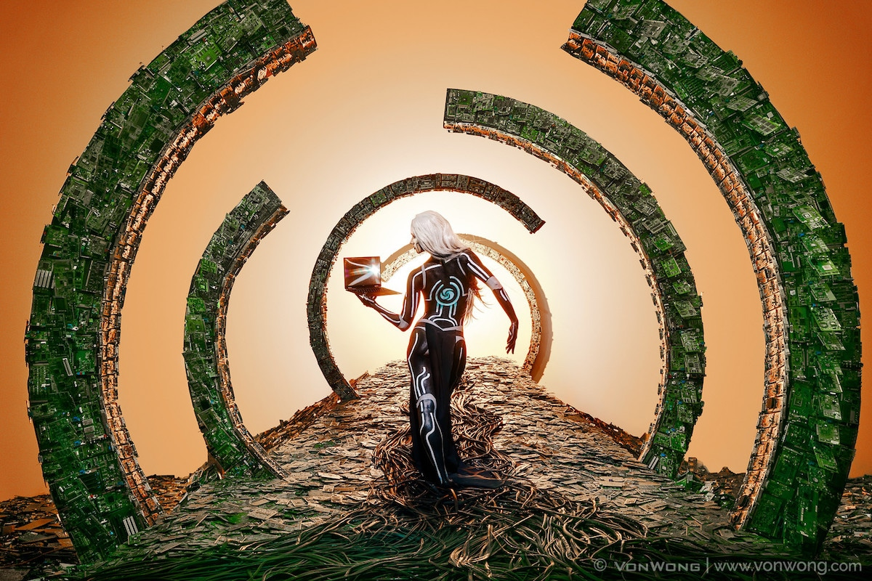

Slide 9
Title of second Artwork:
Computers

Slide 10
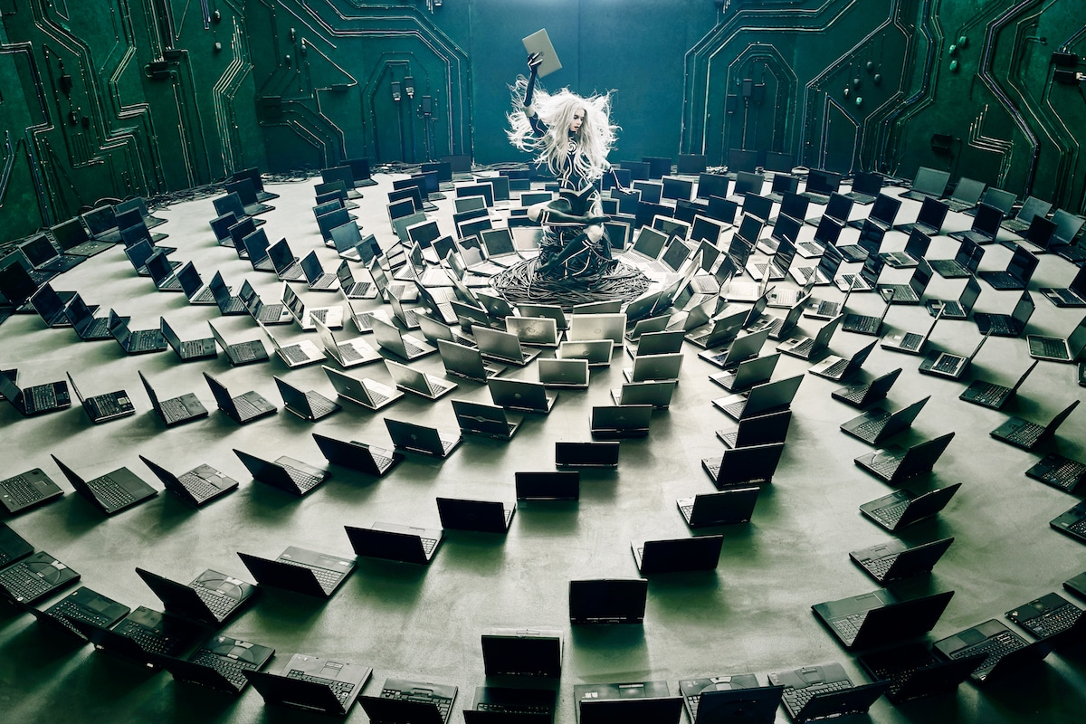

Slide 11
The Spiral Computers

